Slide 1
UNIT-II
LOGIC FAMILIES

Slide 2
CONTENTS
Transistor as a Switch,
Characteristics of Digital ICs, DL, RTL, DTL, TTL, ECL, IIL,
Characteristics and uses of MOSFET (CS, Common drain and Common gate),
MOSFET Logic, PMOS,NMOS, CMOS Logic,
Propagation delay,
Tristate Logic, Tristate Logic Applications,
FPGA Basics,
Introduction to HDL and logic simulation,
HDL System primitives,
user defined primitives,
Stimulus to the design,

Slide 3
IC digital logic families
IC digital logic families
-- DL(Diode-logic)
RTL(Resistor-transistor logic）
DTL(Diode-transistor logic）
TTL(Transistor -transistor logic）
ECL(Emitter-coupled logic）
CMOS(Complementary Metal-oxide semiconductor）

Slide 4
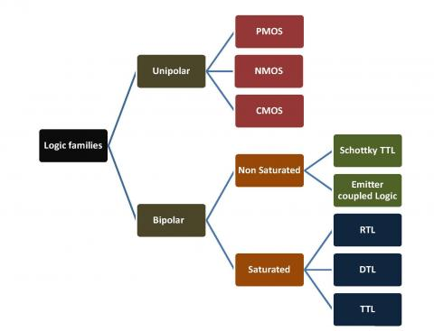
TYPES OF LOGIC FAMILY

Slide 5
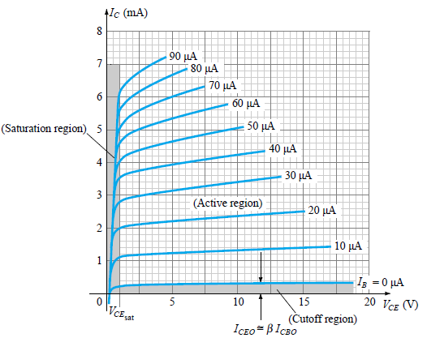
What is meant by Saturated and Non-Saturated Logic
Bipolar logic families are classified as belonging to either saturated or non-saturated logic families.
In saturated logic, the transistor is switched between the off and saturation regions, while in non-saturated logic, the transistor is switched between the off and active regions.

Slide 6
Diode Logic
The diode logic uses diodes and resistors to implement Boolean functions.
Diodes function as a switch that conducts only during the forward biasing condition.
The simplicity in the circuits is the main advantage of diode logic but it lacks amplification of the input signal. This limits the application of diode logic.
The diode logic can implement only logic OR and logic AND operations that are non-inverting.
All other logic operations cannot be implemented using diode logic.
The diodes and resistors are either connected in parallel or series that function as electronic switches controlled by input logical variables.
When the diode is forward biased the switch is closed and when the diode is reverse biased the switch is open.

Slide 7
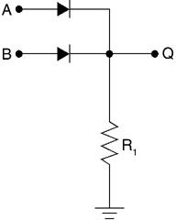
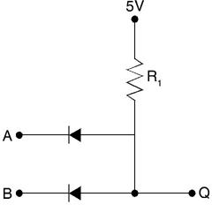
DL OR GATE
DL AND GATE

Slide 8
Disadvantages of Diode Logic
Diode logic only permits the OR and AND functions.
Diode logic suffers from voltage drop from one stage to the next. Unlike the active logic gates that can be integrated to larger components, the diode logic cannot be cascaded as they face few problems.
– The diodes possess a voltage drop of 0.65 V during the forward bias condition. When the identical diodes are cascaded, this voltage is either added to or subtracted from the input of every gate. Thus, this voltage accumulates at each stage.
– The second problem the diodes face during cascading is that of the voltage divider. The input voltage sources possess an internal resistance that joins the gate resistor to produce a voltage divider action on the voltage levels. The source resistance decreases logic 1 level in an OR gate. In an AND gate, the gate resistance increases logic 0 level.
Diode logic is used extensively to produce simple logic functions but not in integrated circuits.
These issues restrict the usage of diode logic and have made them obsolete.

Slide 9
Resistor – Transistor Logic
The resistor-transistor logic (RTL) are digital circuits that are constructed using resistors and bipolar junction transistors (BJTs).
The resistors are the input network while the transistors function as switching devices.
The disadvantage of Diode logic (DL) is overcome using RTL since the transistors not only operate as switches but also amplify signals.
RTL family was the first developed transistor logic circuits that were later improved to form the other classes like
diode–transistor logic (DTL) and
transistor-transistor logic (TTL).

Slide 10
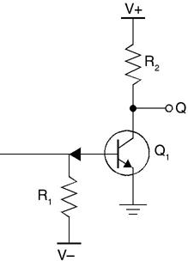
RTL – NOT Gate
Bipolar transistor switch is the simplest RTL gate.
The resistor R₁ in the circuit is used across the base and input terminals.
This resistor increases the voltage drop from 0.7 V to 1 V by converting the input voltage into current.
The resistance R₁ is chosen in such a way that it saturates the transistor and obtains high input resistance.
The collector resistor R₂ converts collector current into voltage.
The resistance of R₂ is high to saturate the transistor and low to obtain output resistance.

Slide 11
Advantages and Limitations of RTL
Minimum transistors are required to implement logic expressions.
RTL leads to the much-improved logic families like diode–transistor logic and then transistor-transistor logic.
The disadvantage is that the RTL has high power dissipation especially when the transistor is at logic 1.

Slide 12
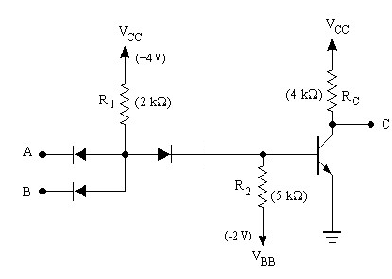

Diode-Transistor Logic (DTL)
Essentially diode logic with transistor amplification
Reduced power consumption
Faster than RTL
=
A | B | NAND o/p
0 | 0 | 1
0 | 1 | 1
1 | 0 | 1
1 | 1 | 0
DL AND gate
inverter
‹#›
Notes:
‹#›
RTL had economic advantage in that very few transistors were used. It was important when transistors were expensive to make (more expensive than resistors). Such times have long past.

Slide 13
Disadvantages of RTL & DTL
The unwanted signals are referred to as noise
Noise margin is the maximum noise added to an input signal of a digital circuit that does not cause an undesirable change in the circuit output .
RTL :
Poor Noise Margin
Poor Fan out
Low Speed
High power dissipation
DTL :
Slow Speed
Improved noise margin & Fan out

Slide 14
TTL (Transistor-Transistor Logic)
The original basic TTL gate was a slight improvement over the DTL gate.
Introduced several TTL subfamilies or series
First introduced by in 1964 (Texas Instruments)
TTL has shaped digital technology in many ways
Transistor alone performs the logical operation & Logic gate operations
Transistors operated in saturation mode and cut off mode.
Fastest of the saturated logic families
Good speed
Low manufacturing cost
Wide range of circuits & applications
Availability in SSI & MSI
Relatively high-power consumption

Slide 15
TTL (Transistor-Transistor Logic)
TTL subfamilies
Standard TTL
High speed TTL
Low power TTL
Schottky TTL
Low power Schottky TTL
Fast TTL
Three different types of output configurations
Open-collector output
Totem-pole output
Three-state (or tristate) output

Slide 16
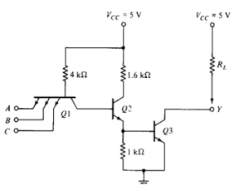
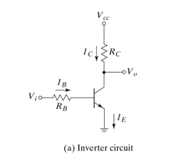
Transistor Operation
When Vin equals 1 (+5V), the transistor is turned on (saturation) and Vout equals 0 (0V).
When Vin equals 0 (0V), the transistor is turned off and Vout equals 1 (5V)

Slide 17
Open Collector TTL – NAND Gate
Transistor Q1 behaves as a cluster of diodes placed back to back.
With any of the input at logic low, the corresponding emitter-base junction is forward biased and the voltage drop across the base of Q1 is around 0.9V, not enough for the transistors Q2 and Q3 to conduct.
Thus the output is either floating or Vcc, i.e. High level.
Similarly, when all inputs are high, all base-emitter junctions of Q1 are reverse biased and transistor Q2 and Q3 get enough base current and are in saturation mode.
The output is at logic low.

Slide 18
What is Totem-Pole Output?
A type of output structure used with integrated circuits in which one transistor drives the output high while another transistor connected below it pulls the output low.

Slide 19
Totem Pole | Open Collector
Output stage of totem pole circuit consists of pull-up transistor, diode resistor and a pull down transistor. | Output stage of Open collector consists of only pull down transistor.
Outputs of the two gates cannot be tied up together | output of two gates can be tied together using a wired AND method.
Operating speed of totem pole circuit is high as compared to open collector | Operating speed is low for open collector
External pull up resistor is not required in case of totem pole | External pull up resistor is required for proper operation of gate in open collectors
Due to the presence of pull up transistor, power dissipation is low in totem pole circuits | In case of open collector, power dissipation is high due to the current flowing trough the extra resistors.

Slide 20
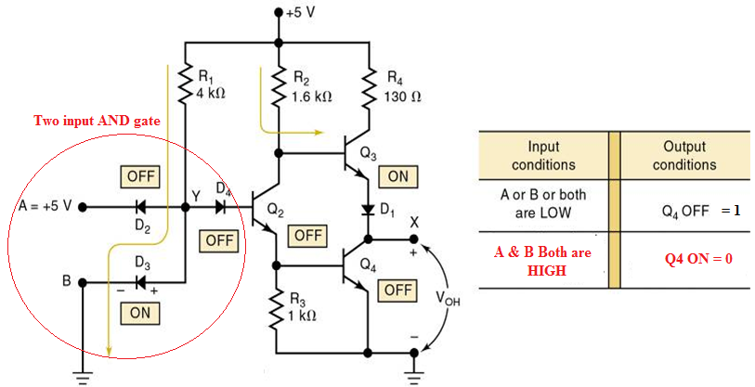
TTL – NAND Gate

Slide 21
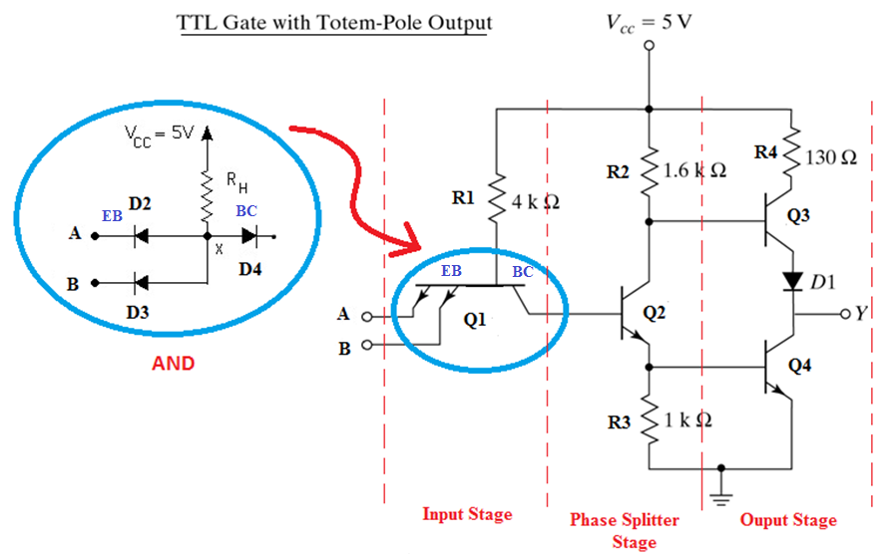
TTL Gate with Totem-Pole Output
Notes:
‹#›

Slide 22
TTL Gate with Totem-Pole Output
Notes:
‹#›

Slide 23
TTL Gate with Totem-Pole Output
O/p impedance of the gate normally resistive &capacitive loads.
Capacitive load consist of capacitance of o/p transistor, capacitance of fan-out gates and any stray wiring capacitances.
When o/p changes from low to high, the o/p transistor of the gate goes from saturation to cut-off and the total load capacitance ‘C’ charges from low to high with time constant RC.
For open collector gate Rl=4kohm, c=15pf ,tpd=35ns. With active pull-up is replaced by passive pull-up circuit tpd is reduced to 10ns. This is called totem pole output.
When o/p Y=low, Q2&Q3 are in saturation. VcQ2=Vbe(Q3)+Vce(Q2)=0.7+0.2=0.9v, Vce(Q3)=0.2V
Q4 is cut-off bcos base of Q4 require 2*0..6=1.2V.

Slide 24
TTL Gate with Totem-Pole Output
When o/p Y=high, one of the i/p drops to low ,Q2&Q3 are in cut-off. o/p remains low bcos the voltage across the load capacitance cannot change instantaneously. As soon as Q2 turns off Q4 conducts bcos base is connected to Vcc through 1.6Kohm.
The current needed to charge the load ‘ C’ causes Q4 to saturate, o/p voltage rises with time constant RC.
R=130ohm+Rsat(Q4)+Rd~=150ohm less compare to passive pull up resistor, so transition from low to high is faster.
When C charges ,o/p voltage rises and current in Q4 decreases so Q4 comes to active region. Final o/p=5v-Vbedrop in Q4-D1 drop=3.6v Q3 goes cut-off very fast. But initial transition Both Q3 &Q4 are on ,peak ct’ is drawn from the supply. This ct’ spikes generates noise.
Change of state is frequent current spikes increases and PD also increases.
Wired connection is not allowed.

Slide 25
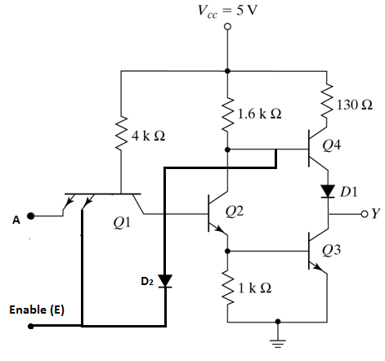
Tri-State Logic
Output can be in 3 states 1. Logic High
2. Logic Low
3. High Impedance State

Slide 26
Three-state TTL with Inverter operation

Slide 27
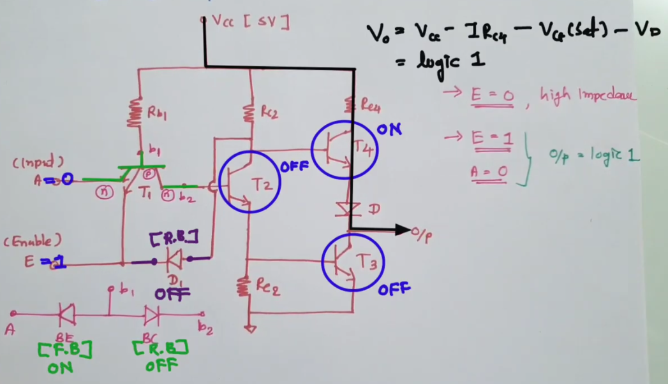
Three-state TTL with Inverter operation

Slide 28
Three-state TTL with Inverter operation

